Slide 1
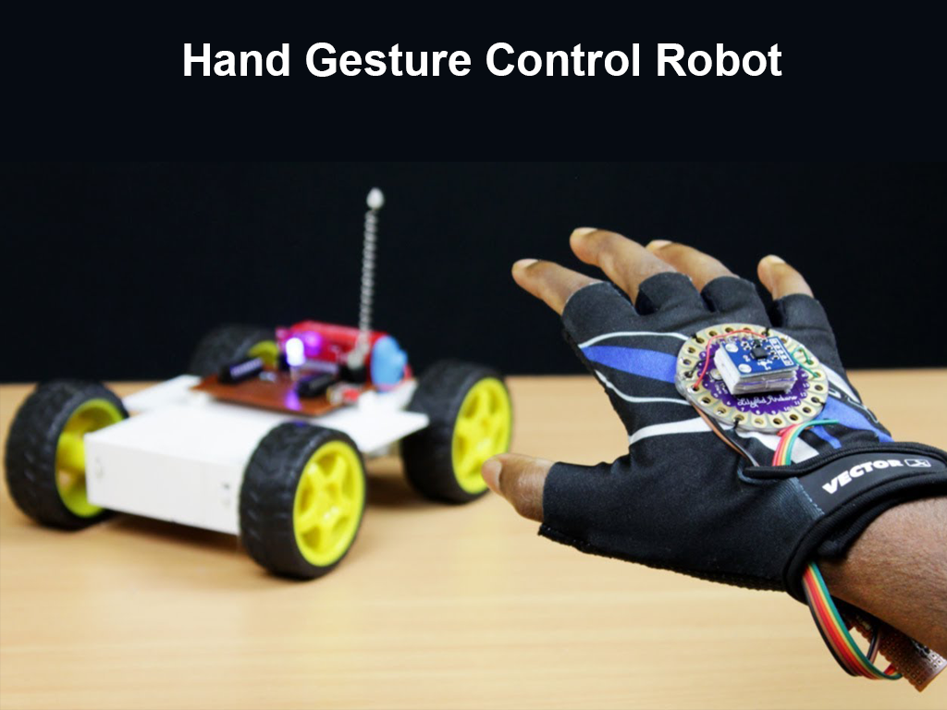

Slide 2
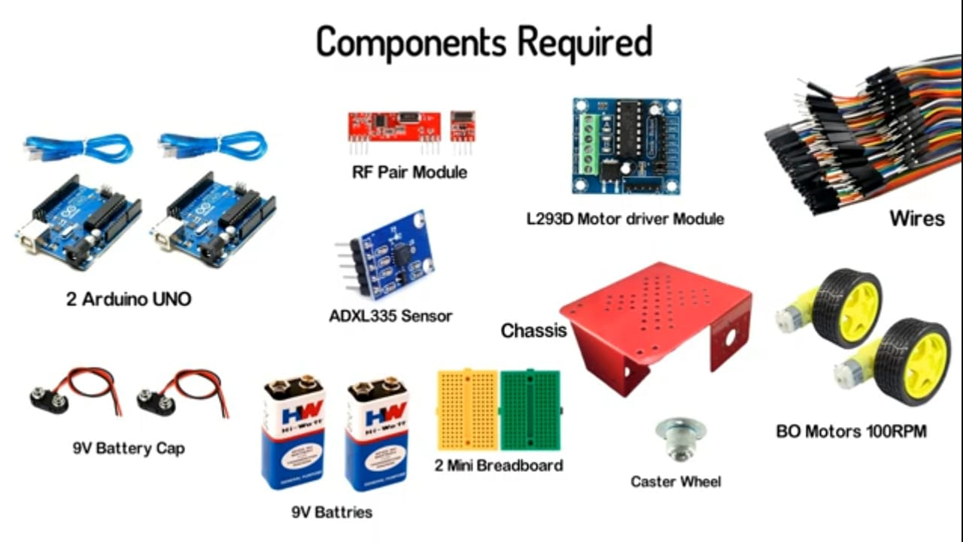

Slide 3
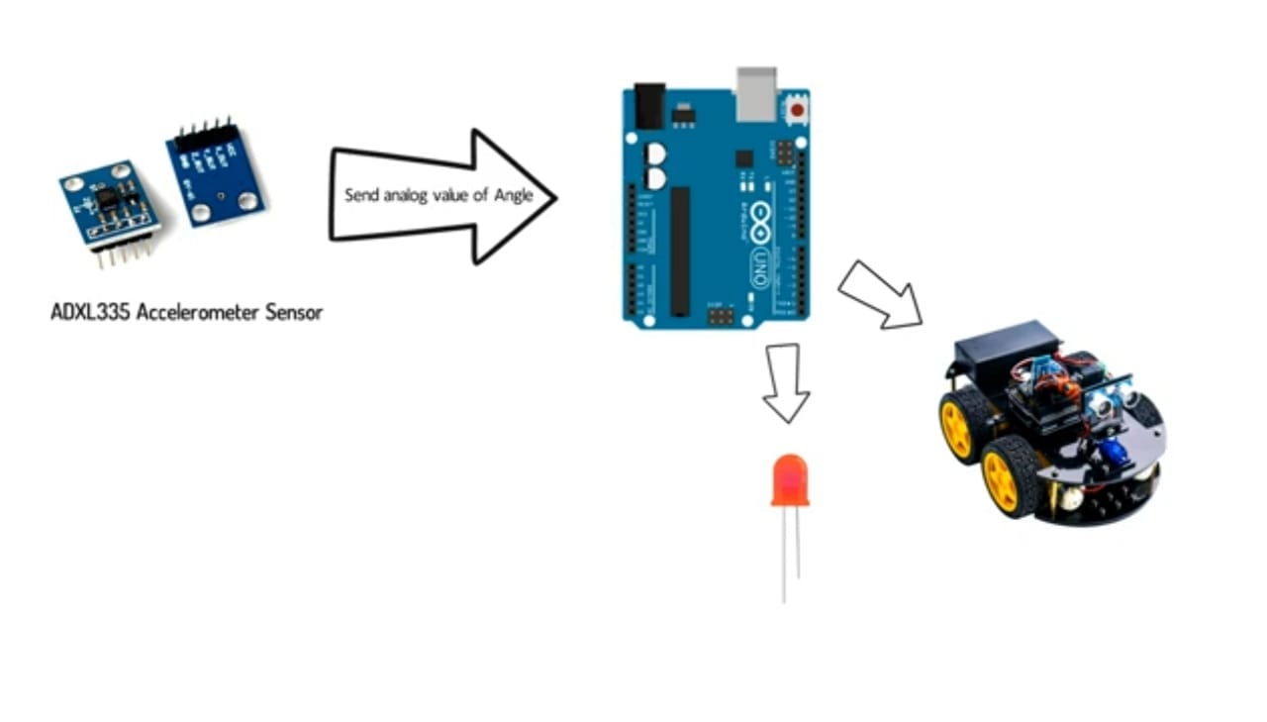

Slide 4
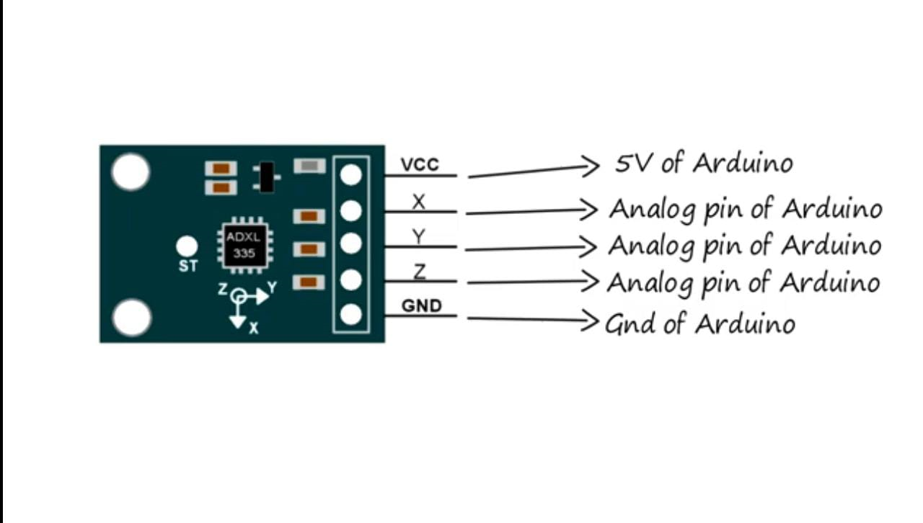

Slide 5
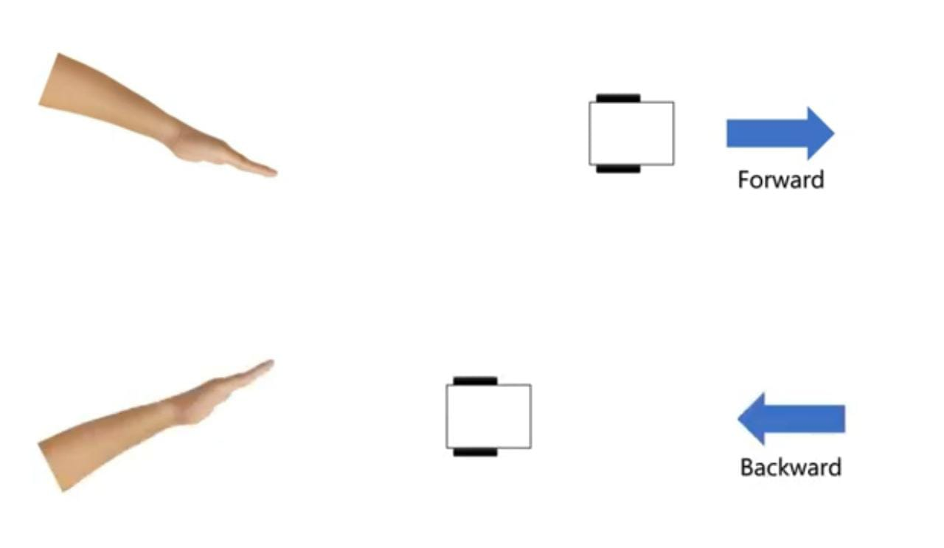

Slide 6
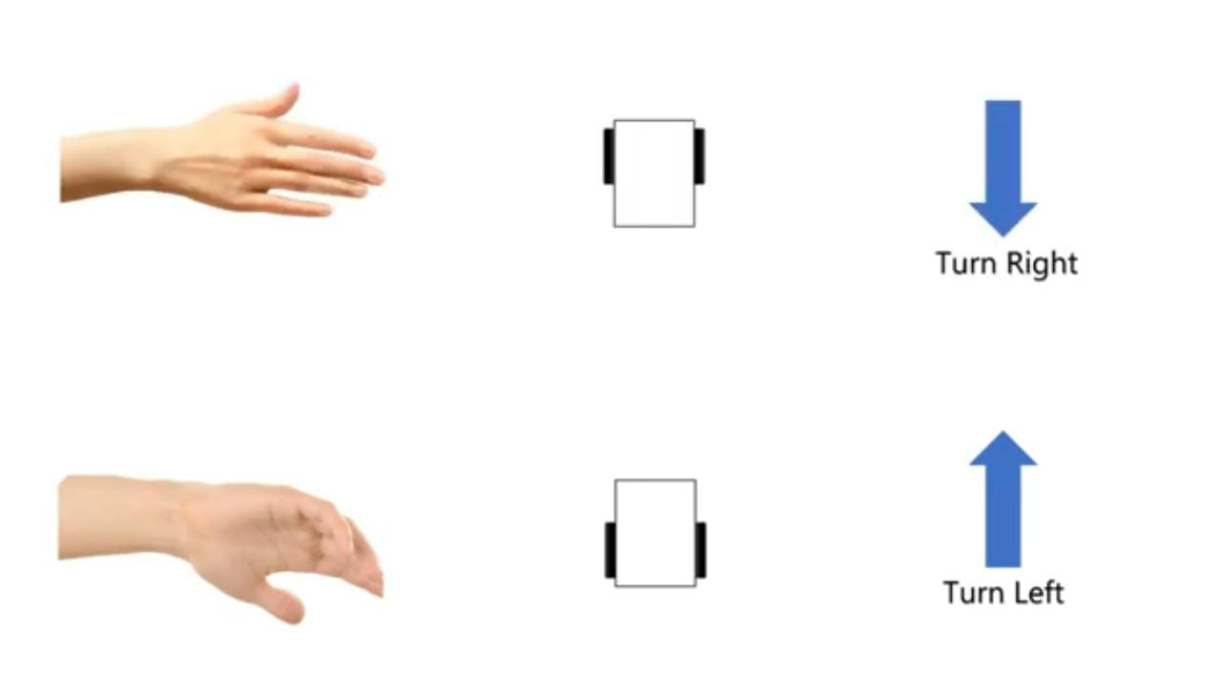

Slide 7
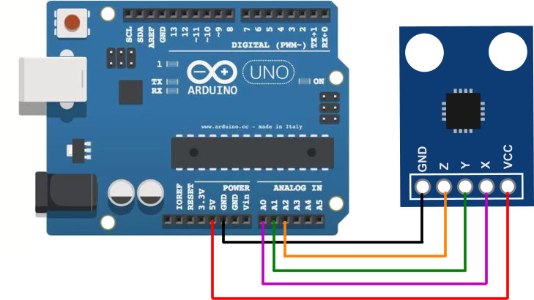
Transmitter Connection

Slide 8
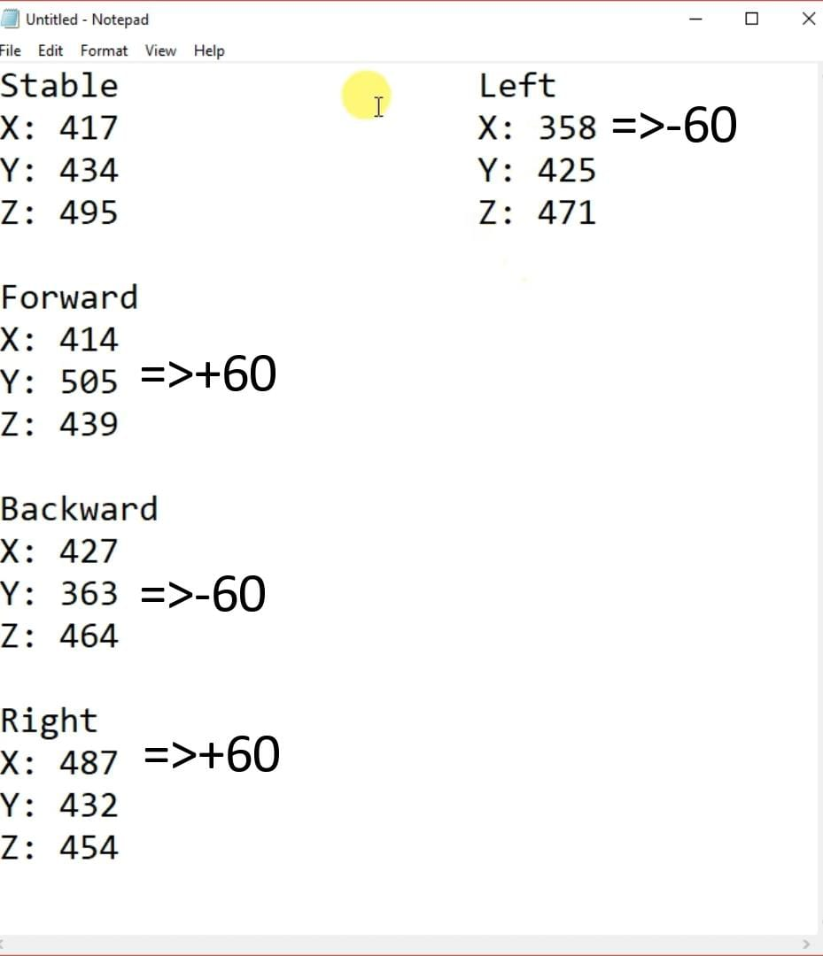

Slide 9
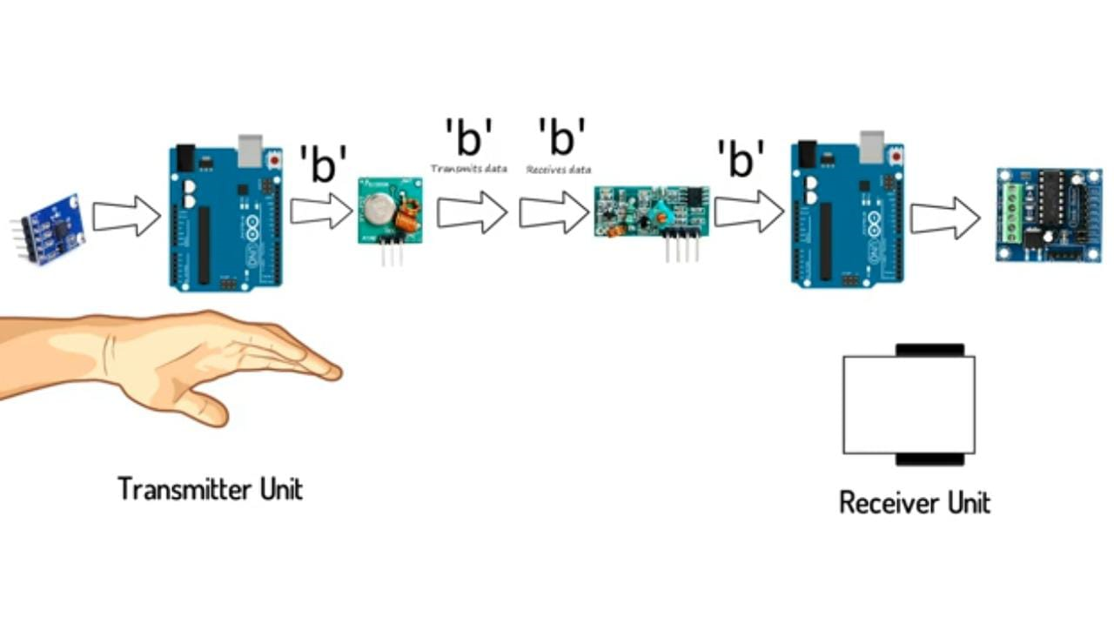

Slide 10
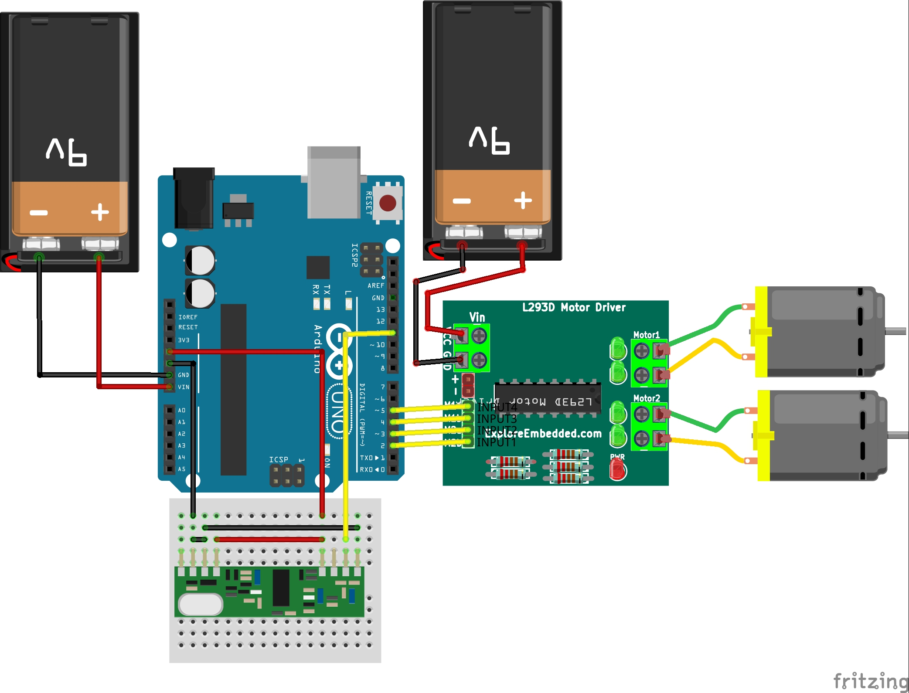
Receiver Connections

Slide 11
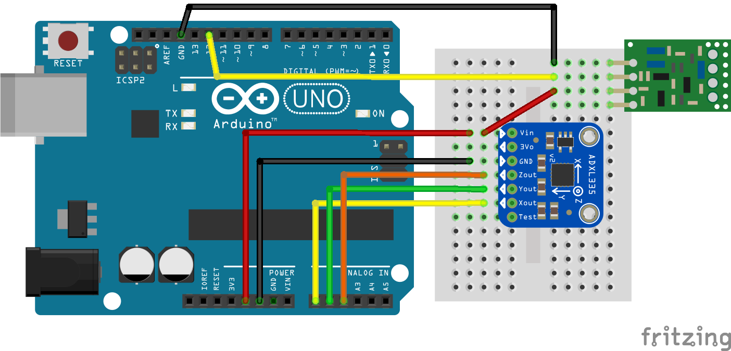

Slide 12
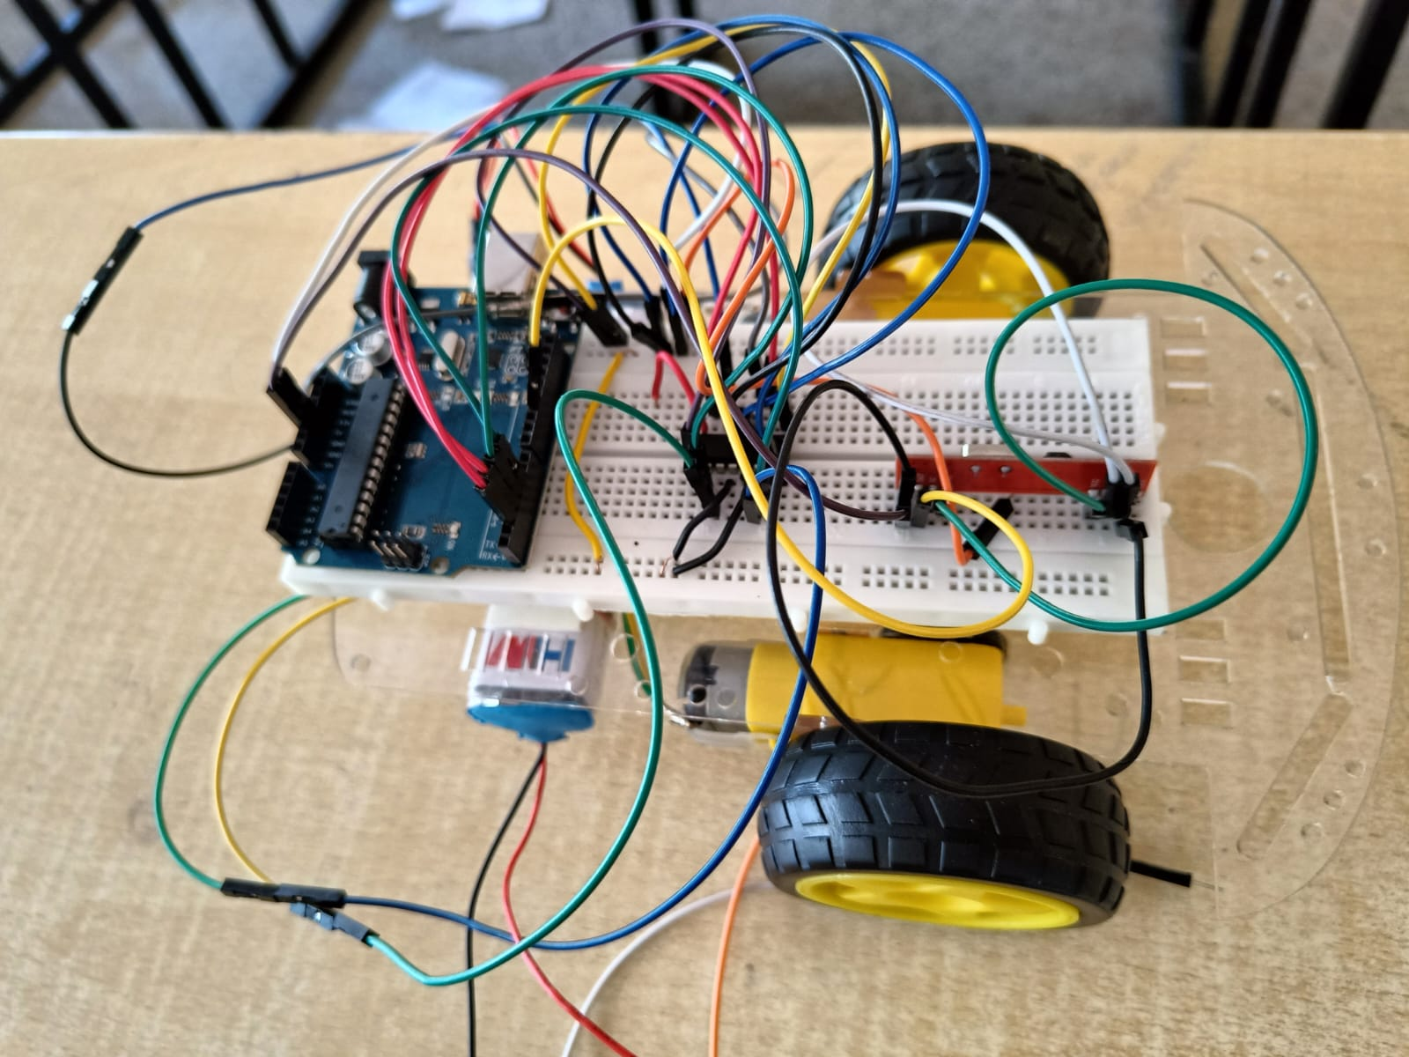
Hardware Setup - Receiver

Slide 13
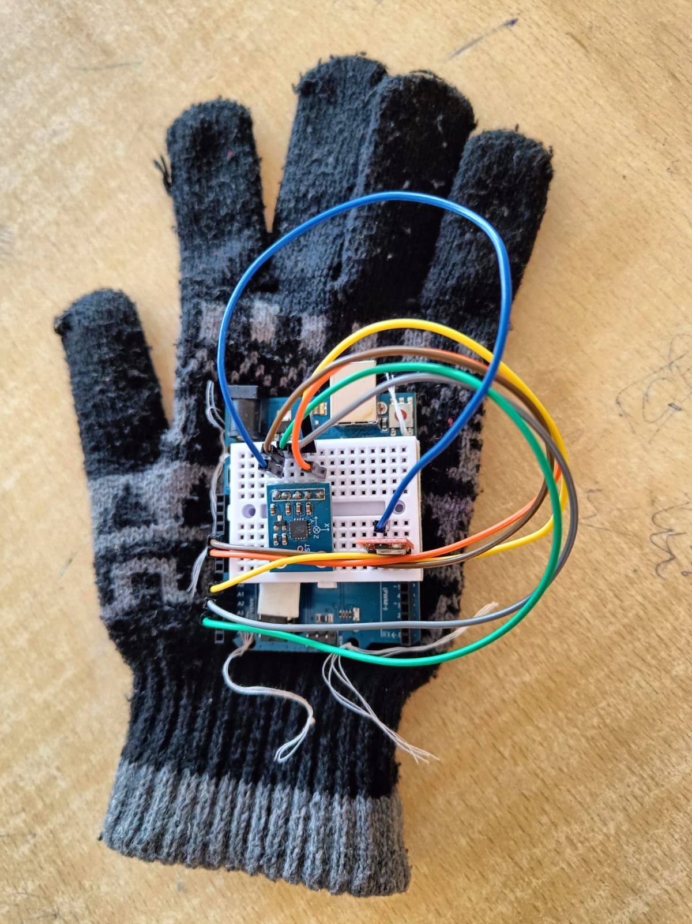
Hardware Setup - Transmitter

Slide 14
RESULTS
Controlled via hand gestures using an accelerometer-based transmitter worn on the hand
Arduino Uno processes commands to drive the robot accordingly
Communication via RF module operating at 434 MHz
Range: Up to 100 meters | Data rate: 1 Kbps – 10 Kbps
Robot contains an RF receiver tuned to the same frequency
RF transmission ensures better range and reliability than Infrared (IR)
Enables wireless control of the robot in real-time based on gesture input

Slide 15
CONCLUSION
A gesture-controlled robot was successfully designed and implemented using Arduino Uno and RF communication.
The system responds accurately to hand gestures, offering a hands-free and intuitive control method.
Use of accelerometer sensors enabled real-time motion detection and command transmission.
The RF module provided a stable, long-range wireless connection, outperforming traditional IR-based systems.
This project demonstrates a cost-effective and efficient approach to wireless human-robot interaction, with potential applications in assistive technology, robotics, and automation systems.

Slide 16
THANK YOU

